Slide 2

Reactive Extensions 101

Slide 3
Goran Šiška
Is: QA Solution Architect at Adacta d.o.o.
Likes: C#
Loves: TDD

Slide 4
Reactive Extensions Is…
A library for composing asynchronous and event-based programs
A mindset

Slide 5
Languages
Java: RxJava
JavaScript: RxJS
C#: Rx.NET
C#(Unity): UniRx
Scala: RxScala
Clojure: RxClojure
C++: RxCpp
Lua: RxLua
Ruby: Rx.rb
Python: RxPY
Go: RxGo
Groovy: RxGroovy
JRuby: RxJRuby
Kotlin: RxKotlin
Swift: RxSwift
PHP: RxPHP
Elixir: reaxive
Dart: RxDart

Slide 6
Interactive vs Reactive
Interactive
Imperative
Pull
For each - do
Reactive
Declarative
Push
On next - call

Slide 7
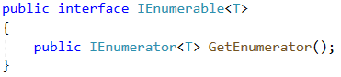
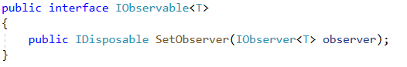
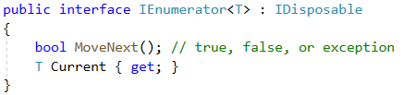
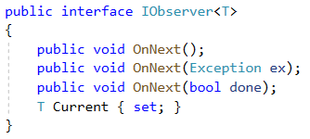
Reactive Extensions Duality
Interactive
Reactive

Slide 8
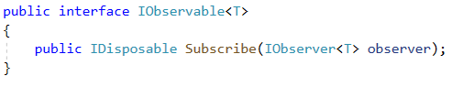
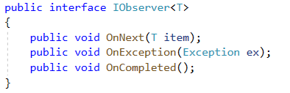
Reactive Extensions Duality
Interactive
Reactive

Slide 9

CoinTrading

Slide 10
Reactive Operators
Creating (Create, Defer, Interval…)
Transforming (Select, SelectMany, Buffer, GroupBy, Scan…)
Filtering (Debounce, Filter, Skip, Distinct…)
Combining (And, Join, Switch…)
Error handling (Catch, Retry)
Utility (Delay, Do, ObserveOn, Timeout…)
Conditionals (All, Contains, SkipWhile, TakeUntil…)
Mathematical (Average, Max, Count, Reduce…)
http://reactivex.io/documentation/operators.html

Slide 11
Creating Observables
Research => IObservable<T>
Events => FromEvent, FromEventPattern
Polling => Interval
Testing => Return, Empty, Never, Throw
Push|Pull =>Create

Slide 12
Concurrency
Default, Immediate, CurrentThread, Dispatcher, Test - Scheduler
Scheduler as parameter
ObserveOn / SubscribeOn

Slide 13

LiveSearch

Slide 14
Error Handling
Subscribe(…, OnError)
Subscriber.OnError
Catch

Slide 15

Testing

Slide 16
UnitTesting
Microsoft.Reactive.Testing
TestScheduler, Recorded & Notification
NUnit, Moq…

Slide 17
Reactive Extensions Resources
Main hub: http://reactivex.io
Operators: http://reactivex.io/documentation/operators.html
Github: http://github.com/dotnet/reactive
Methods visualization: http://rxmarbles.com

Slide 18
Reactive Extensions
Pull vs Pull
RX = Observable + LINQ + Schedulers
Please write tests

Slide 19


